Slide 1
CSM51A Discussion #5
Hyunjin Kim

Slide 2
Outline
Reviews
HW#2, Quiz#1, Practice Midterm
Logisim for HW3
Chapter 7
Mealy vs. Moore machine
State transition table
State Diagram
State Minimization
Quiz2

Slide 3
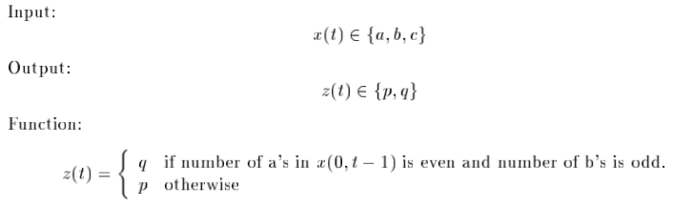
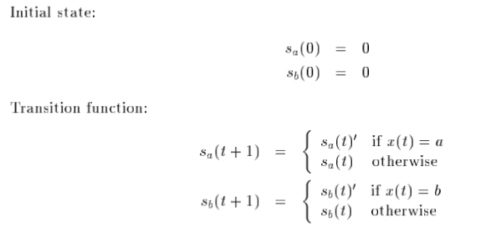
Ex7.1 A sequential system has one input with values a, b, and c and one output with values p and q. The output is q whenever the input sequence has an even number of a’s and an odd number of b’s. Obtain a state description of the system.

Slide 4
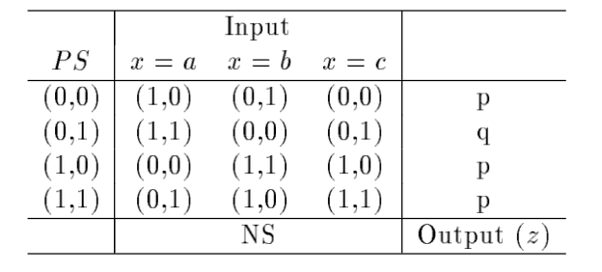
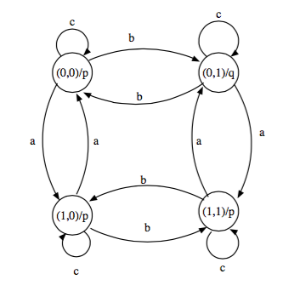

Slide 5
Ex7.5 Determine the state diagram for the sequential system described by the following expressions:
s(t+1) = s(t) if x=a
(s(t)+1) mod 5 if x=b
2 if x=c
z(t) = 0 if s(t) is even
1 if otherwise
The system has five states labeled 0, 1, 2, 3, and 4

Slide 6
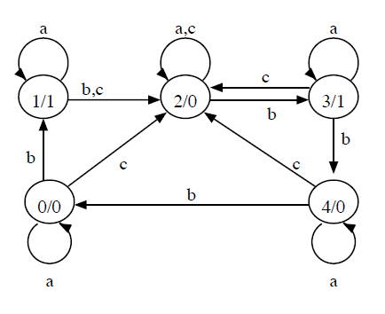
Ex7.5 Solution

Slide 7
Ex7.15 Determine the minimal state table that is equivalent to the following:
 | input
PS | x=0 | x=1
a | f, 0 | b, 0
b | d, 0 | c, 0
c | f, 0 | e, 0
d | g, 1 | a, 0
e | d, 0 | c, 0
f | f, 1 | b, 1
g | g, 0 | h, 1
h | g, 1 | a, 0
 | NS, z

Slide 8
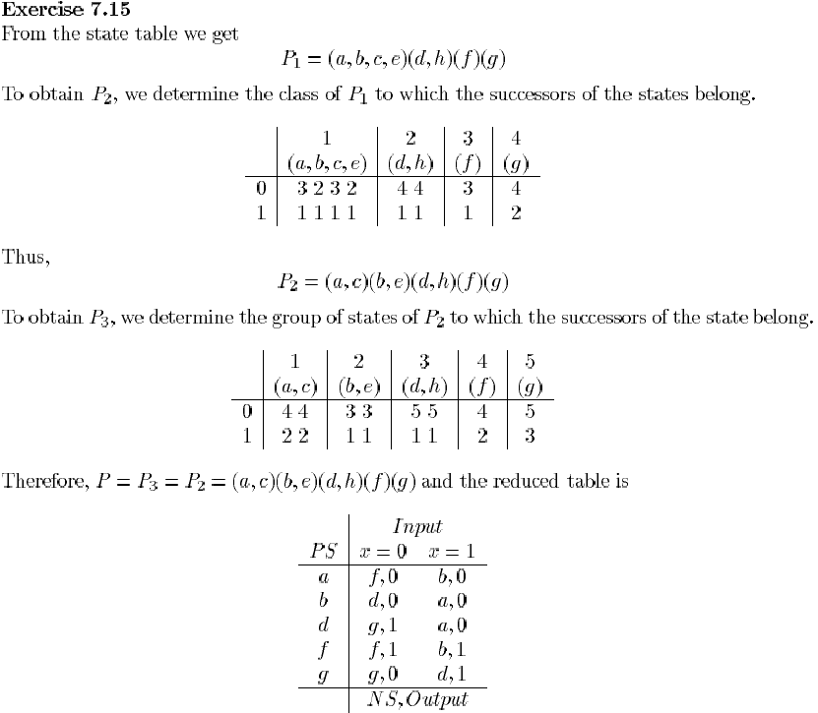

Slide 9
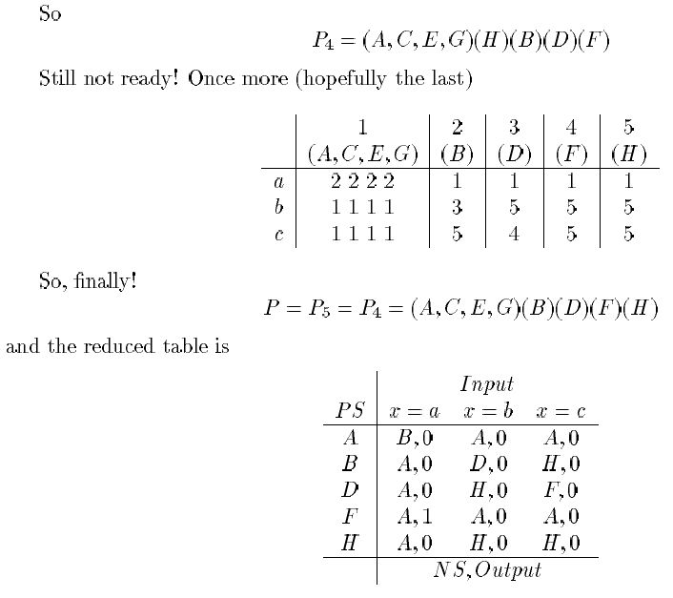

Slide 10
Ex7.17 Determine the minimal state table equivalent to the following one:
 | Input
PS | x=a | x=b | x=c | x=d
A | E, 1 | C, 0 | B, 1 | E, 1
B | C, 0 | F, 1 | E, 1 | B, 0
C | B, 1 | A, 0 | D, 1 | F, 1
D | G, 0 | F, 1 | E, 1 | B, 0
E | C, 0 | F, 1 | D, 1 | E, 0
F | C, 1 | F, 1 | D, 0 | H, 0
G | D, 1 | A, 0 | B, 1 | F, 1
H | B, 1 | C, 0 | E, 1 | F, 1
 | NS, z

Slide 11
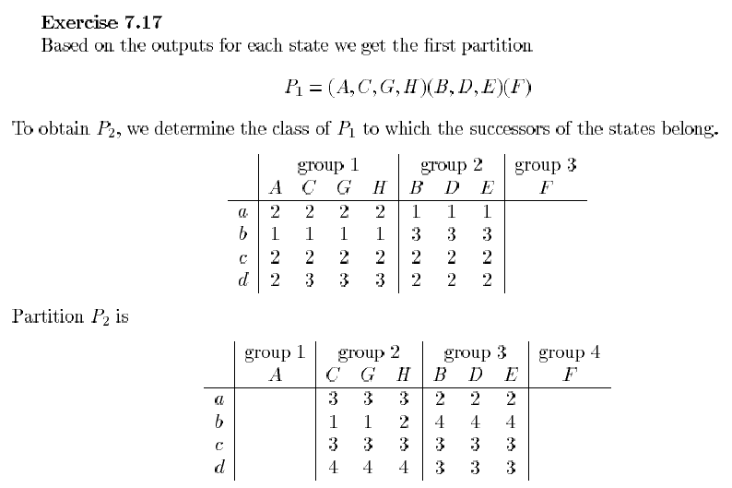

Slide 12
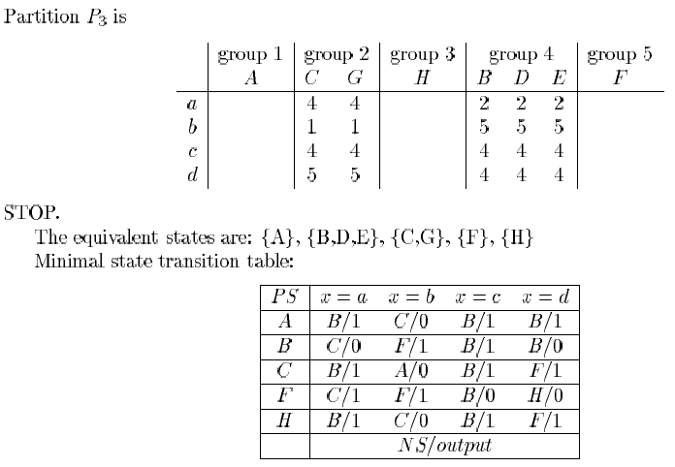

Slide 13
Ex7.14 A sequential system has an input with values a, b, and c, and one binary output. The output at time t is 1 if x(t-3, t) = abca and the number of a’s in x(0, t) is even. Obtain a “loose” state description and minimize the number of states

Slide 14
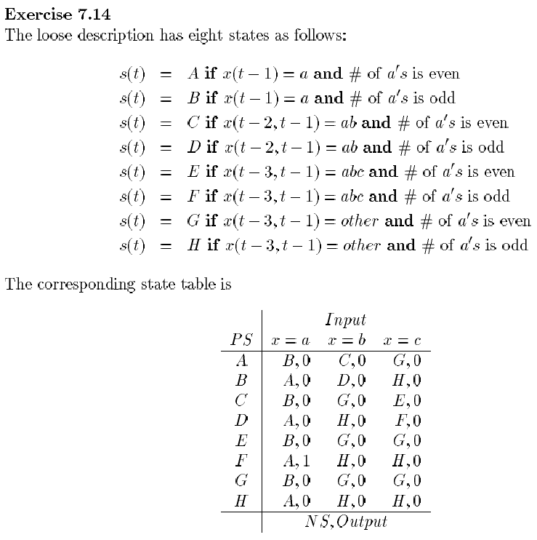

Slide 15
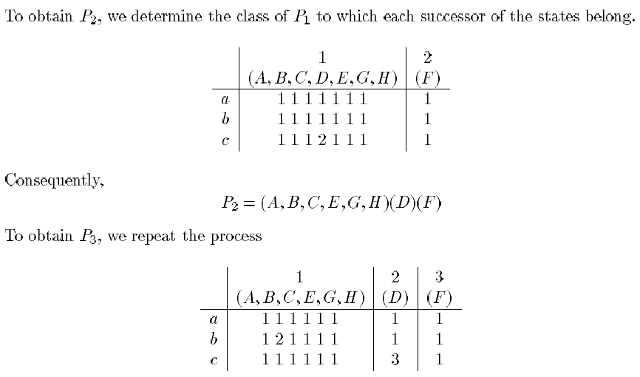
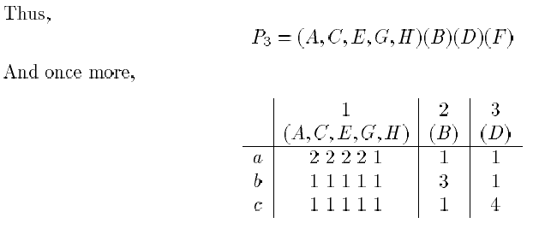

Slide 17
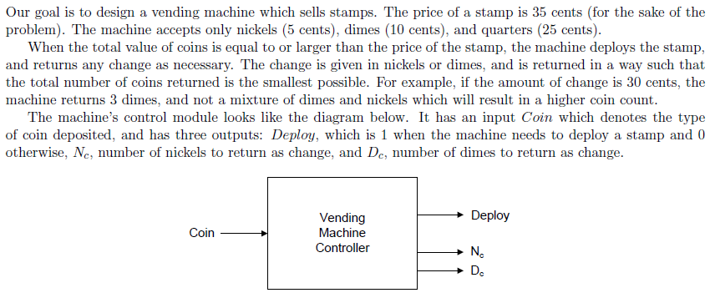
Can you make this stamp vending machine without states?
You may change it’s specification.

